Slide 1
3D Image & Video Processing
Under supervision of
Dr. Mai Kamal
Presented by :
Eng/ Abeer Al-Sayed
Eng/ Sara Ahmed
Eng/ Omar AbdElhameed
Eng/ Rahma Nabil

Slide 2
Table of contents
01
03
02
04
Structure from Motion (SfM) and SLAM
Stereo vision and depth estimation
3D reconstruction from images
Applications in AR/VR and robotics

Slide 3
Stereo Vision & Depth Estimation

Slide 4
What is Stereo Vision?
Stereo Vision is a way to obtain 3D depth information about a scene using two (or more) 2D images.
This concept is used by humans, animals, and now increasingly by computers.
It has been studied extensively over the last 25 years and is still a subject of active research.
While challenging, there are now commercial systems available for stereo vision applications.
To perform stereo camera calibration, we need two cameras to capture the scene from different viewpoints

Slide 5
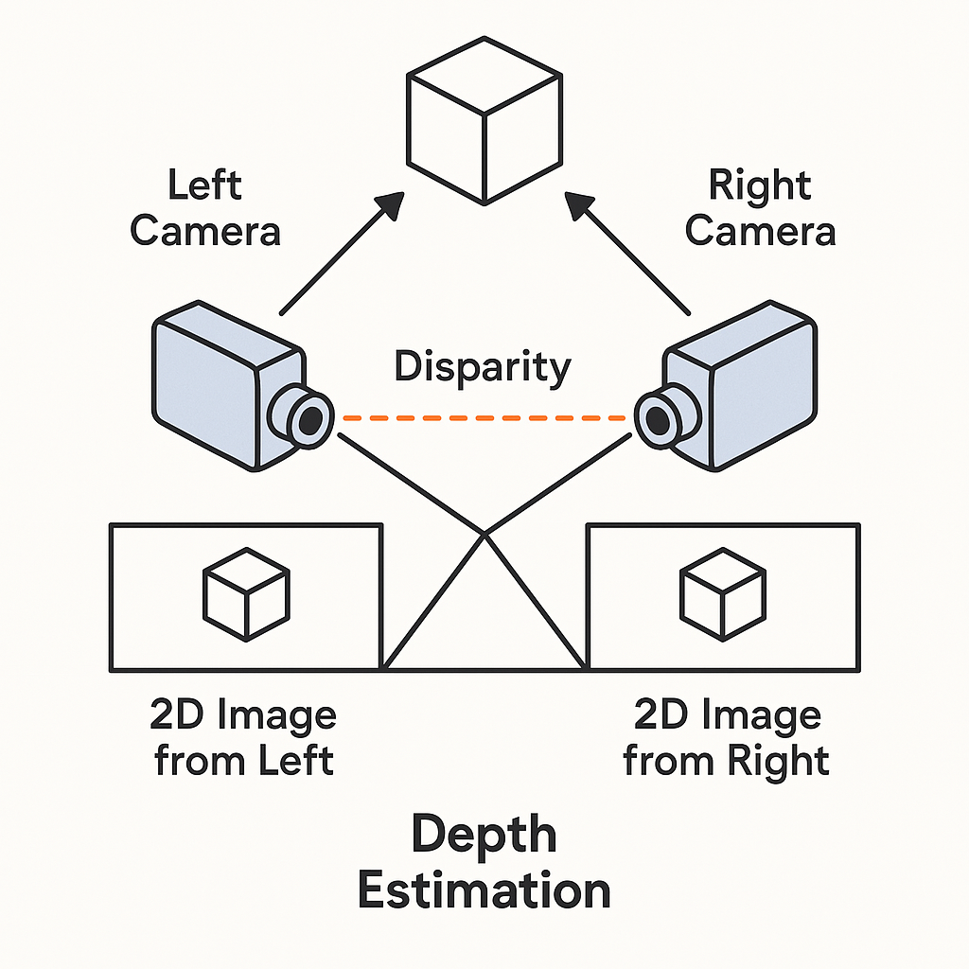
Stereo Vision and Depth Estimation
Stereo vision is the technique of using two or more cameras to capture images from different viewpoints and reconstruct the 3D structure of a scene.
This process relies on depth estimation, where the disparity (difference) between the images is used to calculate the distance of each point in the scene from the cameras.
✅ Stereo vision uses depth estimation to turn 2D images into 3D understanding.

Slide 6
?
How Stereo Vision Works

Slide 7
How Stereo Vision Works
Two images are taken from different angles.
The disparity between corresponding points is calculated.
The depth map is generated by computing the 3D coordinates.

Slide 8
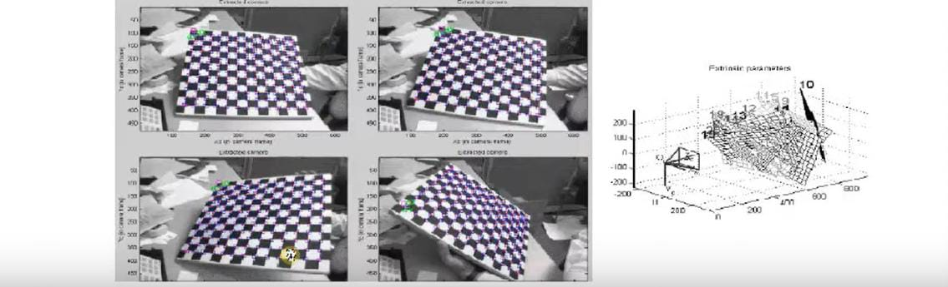
Camera Calibration
Measure all unknown parameters to form the camera model (intrinsic & extrinsic). Use the model to understand the projection from world to image plane. By knowing the pixel coordinates of the image points p and the 3D coordinates of the corresponding scene points P, it is possible to compute the unknown parameters K, R, T, and by solving the perspective projection equation.

Slide 9
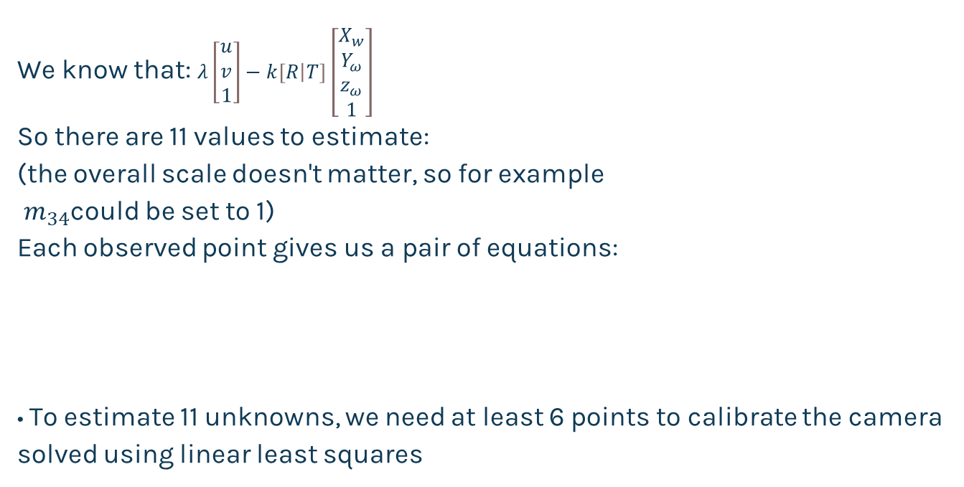
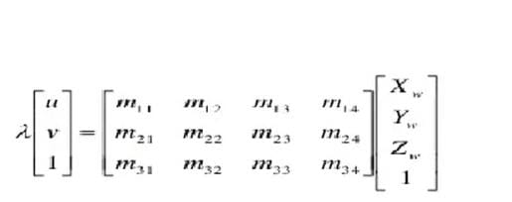
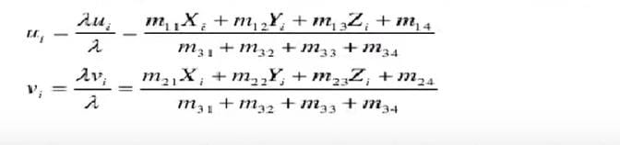
Camera Calibration

Slide 10
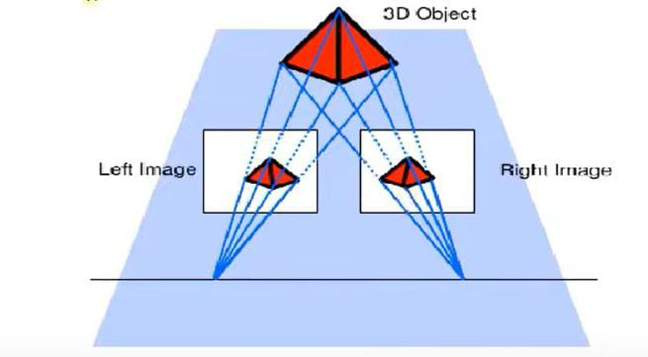
How do we measure distances with cameras?
Impossible to capture 3D structure from a single image. We can only deduct the ray on which each image point lies.
Observe scene from 2 different viewpoints solve for the intersection of the rays and recover the 3D structure

Slide 11
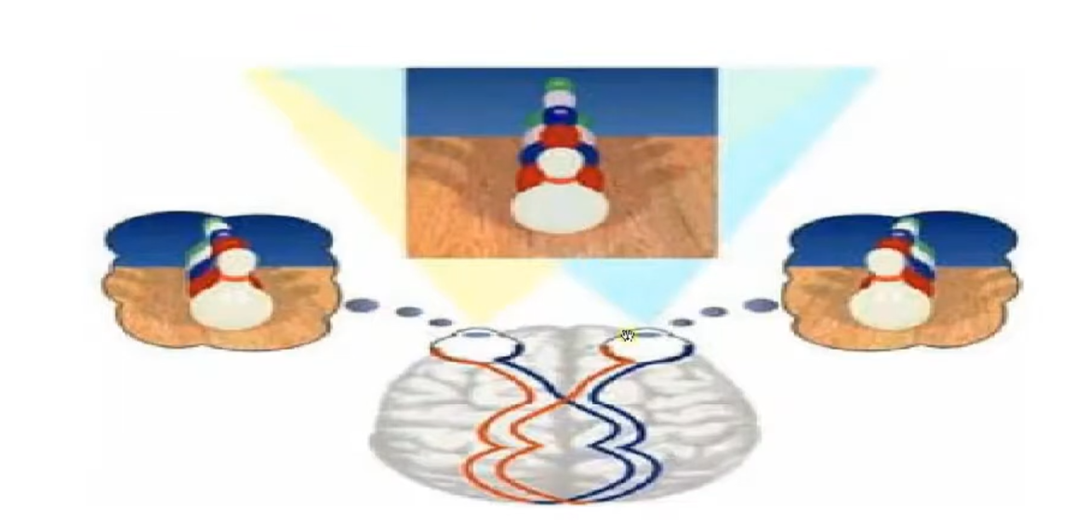
Disparity in the human retina

Slide 12
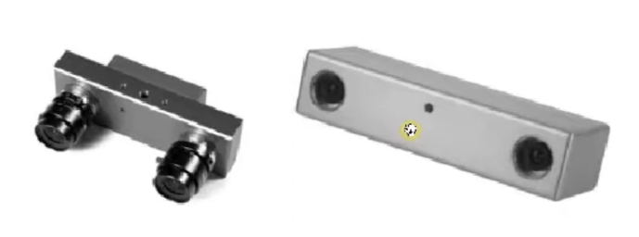
How do we measure distances with cameras?
Structure from stereo (Stereo-vision):
use two cameras with known relative position and orientation
Structure from motion:
use a single moving camera: both 3D structure and camera motion can be estimated up to a scale

Slide 13
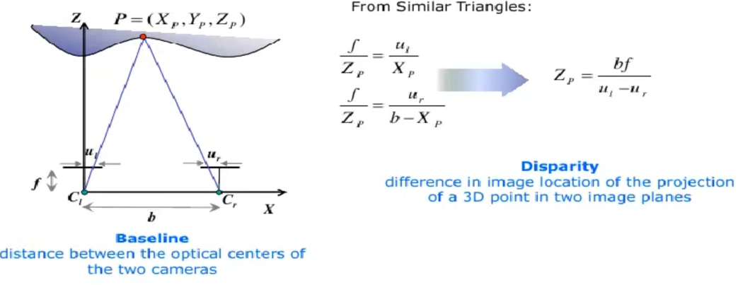
Stereo Vision - The simplified case
The simplified case is an ideal case. It assumes that both cameras are identical and are aligned on a horizontal axis

Slide 14
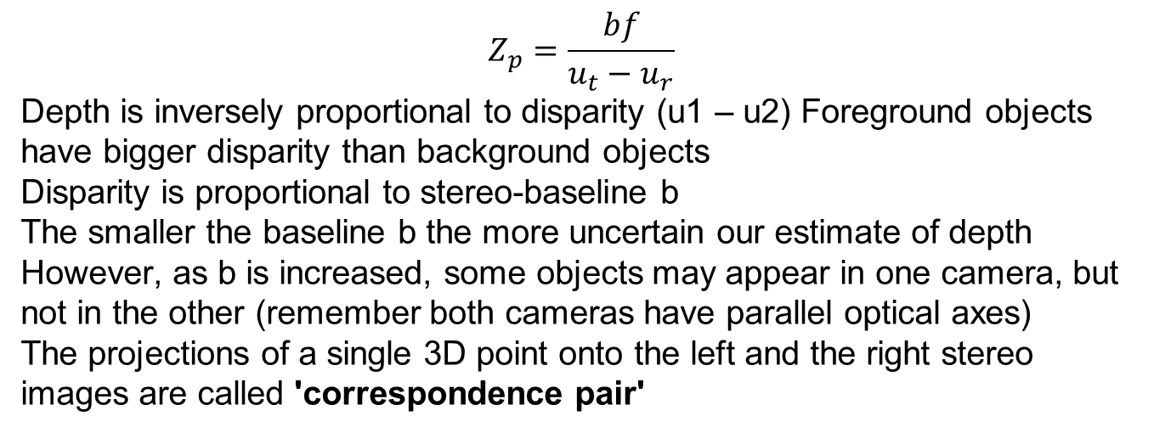
Stereo Vision facts

Slide 15
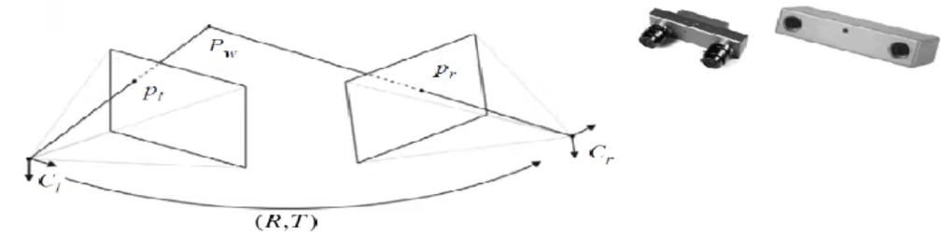
Stereo Vision - the general case
Two identical cameras do not exist in nature!
Aligning both cameras on a horizontal axis is very hard -- even in the most expensive stereo cameras
To be able to use a stereo camera, we need the
relative pose between the cameras (rotation, translation), and
the focal length, image center, radial distortion of each
Use a calibration method, as mentioned before

Slide 16
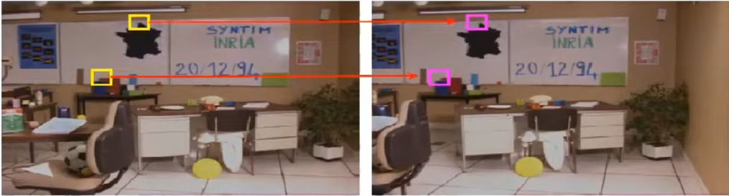
Correspondence Problem
Which patch in the Left image, corresponds to the projection of the same 3D scene point on the Right image?
Correspondence search could be done by testing the query-patches at all pixel positions in the other image. Typical similarity measures are the Cross-Correlation and Sum of Squared Differences
Exhaustive image search can be computationally very expensive! Is there a way to make the correspondence search 1-dimensional?

Slide 17
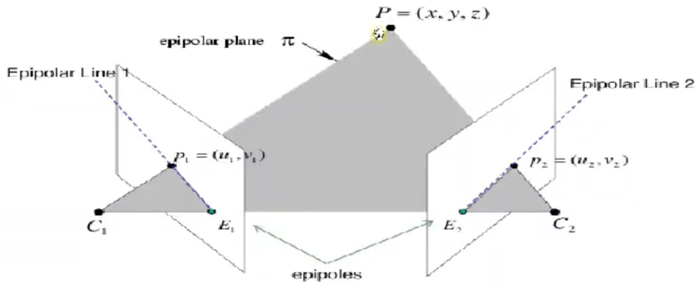
Epipolar Geometry
Triangulating 2 rays from image correspondences
Impose the epipolar constraint to aid matching: search for a correspondence along the epipolar line
The epipolar plane is defined by a 3D point P and the optical centers.

Slide 18
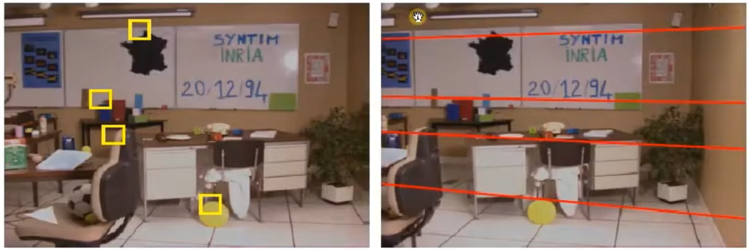
Correspondence Problem: Epipolar Constraint
Thanks to the epipolar constraint, conjugate points can be searched along epipolar lines: this reduces the computational cost to 1 dimension!

Slide 19
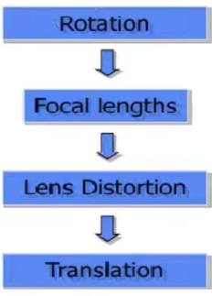
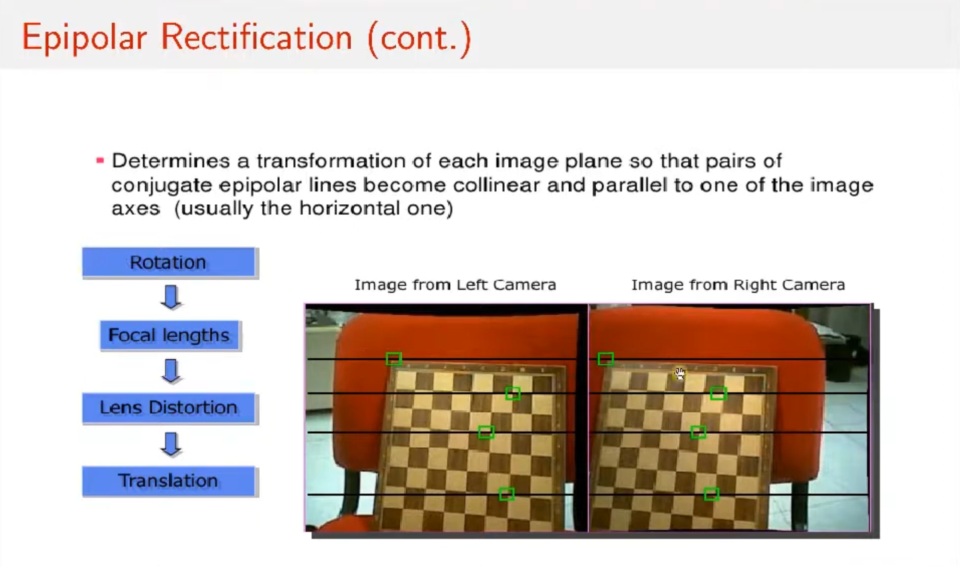
Epipolar Rectification
Determines a transformation of each image plane so that pairs of conjugate epipolar lines become collinear and parallel to one of the image axes (usually the horizontal one)

Slide 20
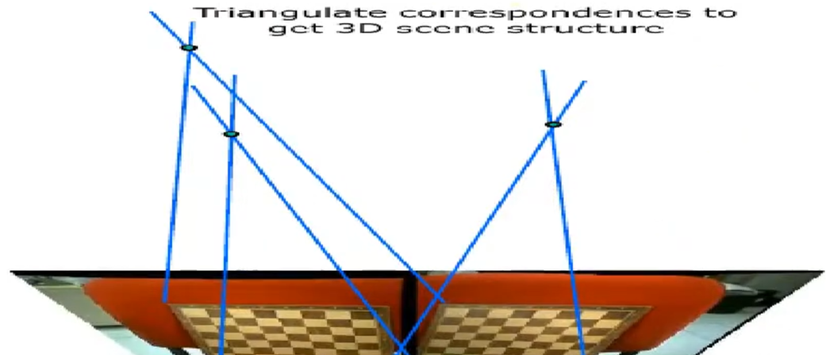
Epipolar Rectification
Stereo Vision Output 2- 3D Reconstruction via triangulation

Slide 21
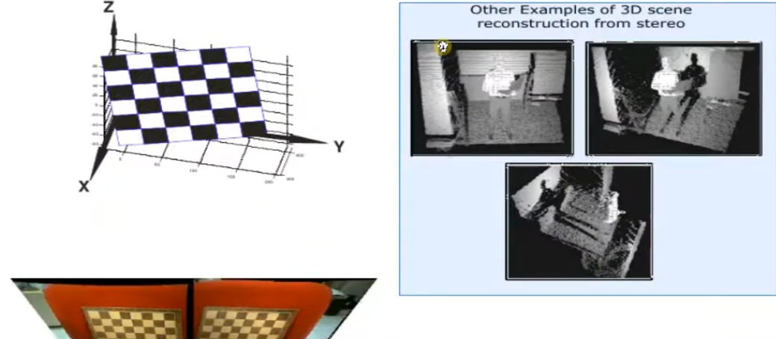
Stereo Vision Output 2- 3D Reconstruction via triangulation (cont.)

Slide 22
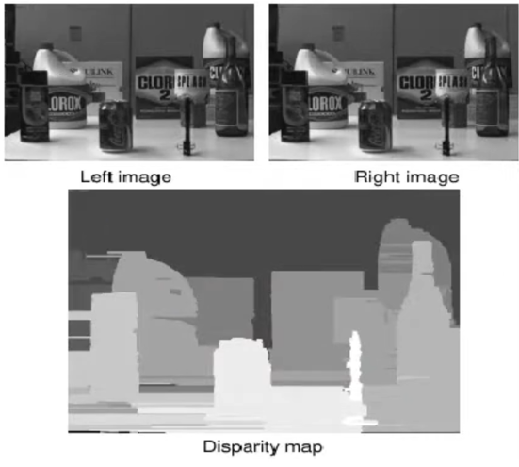
Stereo Vision Output 1 - Disparity map
Find the correspondent points of all image pixels of the original images
Compute the disparity for each pair of correspondences
Disparity map: holds the disparity value at every pixel
Usually visualized as grey-scale images. If lighter color corresponds to larger disparities, then objects closer to the camera appear lighter, than those further away.

Slide 23
Advantages and Challenges
advantage
advantage
Provides depth information
Allows for 3D scene reconstruction.
Challenge
Challenge
Requires precise calibration.
Limited by lighting conditions and occlusions.

Slide 24
Applications of Stereo Vision
- Robotics: Enabling robots to navigate and understand their environment.
- Autonomous Vehicles: Helping self-driving cars detect obstacles and plan paths.
- Medical Imaging: Reconstructing 3D models from medical scans.
- 3D Modeling: Generating realistic 3D models from stereo image pairs.

Slide 25
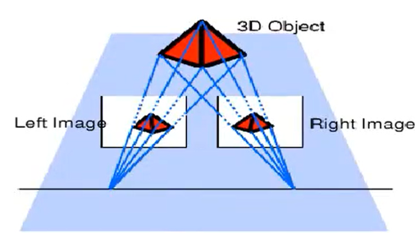
Stereo Vision - summary
1. Stereo camera calibration compute camera relative pose
2. Epipolar rectification align images & epipolar lines
3. Search for correspondences
4. Output: compute stereo triangulation or disparity map
5. Consider baseline and image resolution to compute accuracy

Slide 26
3D Reconstruction

Slide 27
3D Reconstruction from images:
The process of creating a three-dimensional model of a real-world object or scene by analyzing two-dimensional photographs.
uses geometric and photometric information from multiple images captured at different viewpoints to infer the 3D shape and structure.

Slide 28
Why reconstruct 3D models from 2D images?
2D images provide limited information about depth and true shape.
3D models offer a more realistic and complete representation of objects and scenes.
Widely used in important applications such as:
Virtual Reality (VR) and Augmented Reality (AR)
Game design and animation
Cultural heritage preservation and archaeology
Robotics and autonomous vehicles

Slide 29
3D Reconstruction Steps:
📸 Take photos: Capture multiple images from different angles.
🔍 Detect features: Identify key points in each image using feature detection techniques.
📐 Match features: Perform feature matching to find corresponding points between images.
🧩 Calculate depth: Use triangulation and the Fundamental Matrix to estimate the 3D positions (depth) of matched points.
🖌️ Create 3D model: Build a textured 3D surface from the estimated points

Slide 30
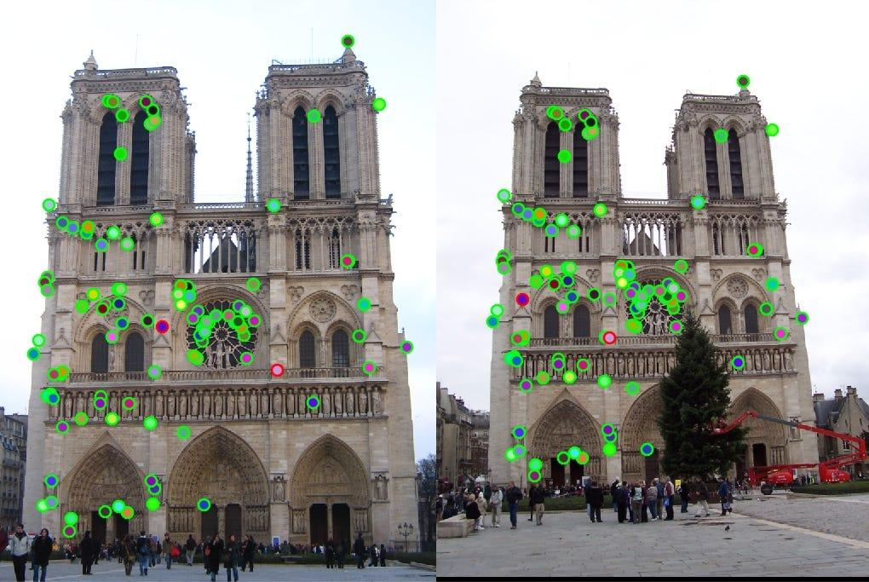
Feature Detection
Identify keypoint features such as mountain peaks, building corners, doorways, etc.
Detect edges like the profile of mountains against the sky.
Extract relevant characteristics from the input image for further processing.
Common methods: SIFT, SURF, ORB are popular algorithms used for detecting features.

Slide 31
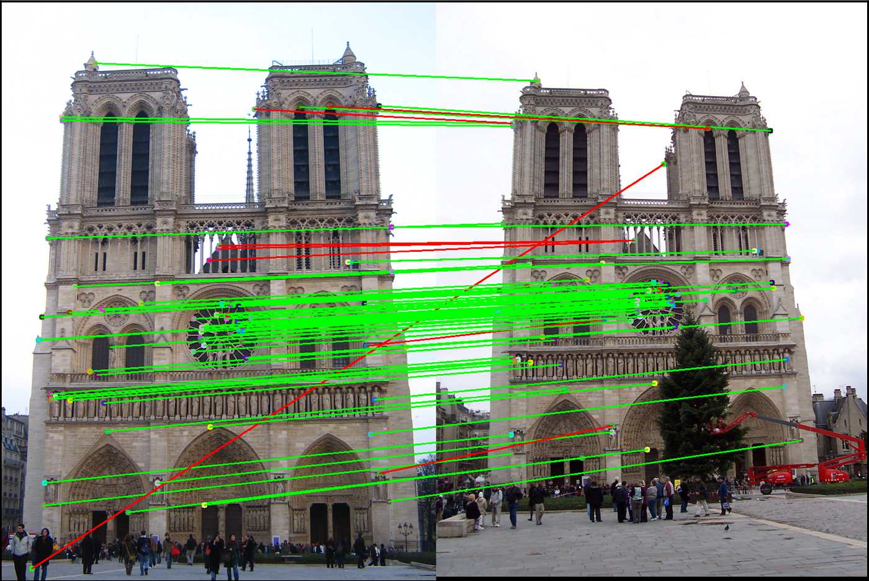
Feature Matching
Find corresponding points in different images that represent the same location.
Compare feature descriptors to find the best matches.
Use methods like nearest neighbor search and RANSAC to improve accuracy.
Accurate matching is essential for correct 3D reconstruction

Slide 32
Geometric Relations Between Images
After detecting and matching features, we need to understand the geometric relationship between the images.
The Fundamental Matrix encodes this relationship and tells us how points in one image correspond to lines (called epipolar lines) in the other image.
This helps to restrict where matching points can lie, reducing errors and speeding up the matching process.

Slide 33
Geometric Relations Between Images
When capturing a 3D scene with two cameras, each 3D point X projects to points x and x′ in the two images.
These projections are related by the cameras’ geometry and relative positions.
Understanding this geometric relation is essential for reconstructing the 3D scene from 2D images.

Slide 34
Epipolar Geometry
For a point x in image 1, its corresponding point x′ in image 2 must lie on the epipolar line l′.
The epipolar line l′ is defined by: l′=Fx
Here, F is the Fundamental Matrix, encoding the geometric relation between the two views.
This constraint reduces the search for corresponding points to a line instead of the whole image.

Slide 35
Fundamental Matrix (F)
The Fundamental Matrix (F) is a 3×3 matrix that relates corresponding points between two images.
For any point x in image 1, the corresponding point x′ in image 2 lies on the epipolar line l′=Fx.
The epipolar constraint is: x′ Fx=0.
x and x′ are points in homogeneous coordinates: (x, y, 1) and (x', y', 1).
F encapsulates the geometric relation without needing camera calibration.
Estimating F is the key step before 3D reconstruction.

Slide 36
Essential Matrix (E)
The Essential Matrix (E) relates corresponding points between two calibrated images.
It works in normalized camera coordinates.
Relation to Fundamental Matrix: E = K' FK where K and K′ are the intrinsic calibration matrices.
The epipolar constraint still holds: x' Ex = 0
From E, we can recover the relative rotation (R) and translation (t) between the cameras.

Slide 37
Triangulation — Recovering 3D Points
Once the Fundamental Matrix F (or the camera matrices) is known, we can triangulate matched points from two images to find their 3D coordinates.
Triangulation uses the projections x and x′ of the same 3D point in two images.
By finding the intersection of the rays back-projected from each image point, we estimate the 3D location of the point X.
Mathematically, triangulation solves for X such that: x=P X and x′=P′ X . where P and P′ are the camera projection matrices.
Accurate triangulation depends on good feature matching and accurate camera geometry

Slide 38
Challenge | Impact | Example
Textureless Surfaces | Feature detection fails (no keypoints). | Plain white walls, smooth objects.
Lighting Changes | Alters feature appearance, causing mismatches. | Shadows/glare across images.
Occlusions | Missing parts in the 3D model. | Objects behind barriers.
Dynamic Scenes | "Ghost" artifacts from moving objects. | People walking in a scene.
Computational Cost | Slow processing for high-res/many images. | 1000+ photos → hours of computation.

Slide 39
From Two Images to Full 3D Understanding
So far, we have seen how to reconstruct 3D information from two images.
But what if we have many images or a moving camera?
This leads us to more powerful techniques:
Structure from Motion (SfM) — Reconstructing 3D scenes from multiple views.
Simultaneous Localization and Mapping (SLAM) — Mapping and tracking at the same time in dynamic environments.

Slide 40
3D Reconstruction in Robotics
Role: Creates environmental models for planning and interaction.
Applications:
Warehouse mapping.
Search and rescue operations.
Example: Reconstructing disaster zones for navigation.

Slide 41
Structure From Motion (SFM)

Slide 42
Content:
(SFM) is a photogrammetric technique used to estimate three-dimensional structures from two-dimensional image sequences.
Objective: Provide a detailed explanation of how SfM works, its Principles, and key concepts.

Slide 43
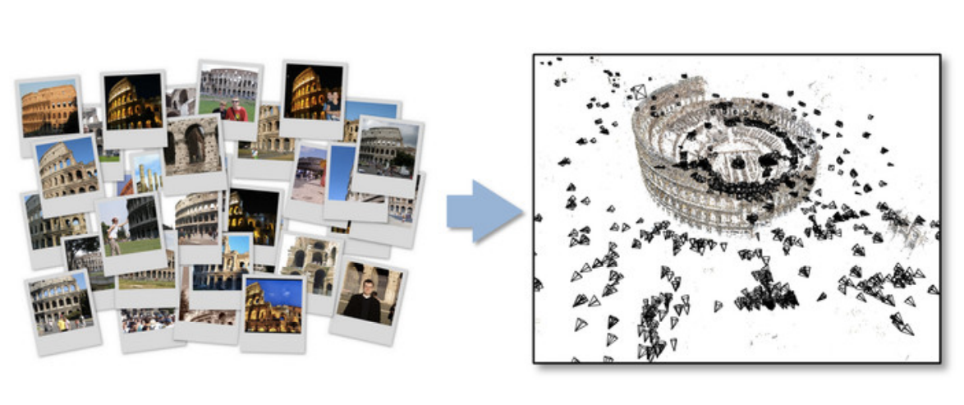
Structure from Motion (SfM)
Given many images, how can we
a) figure out where they were all taken from?
b) build a 3D model of the scene?
This is (roughly) the structure from motion problem

Slide 44
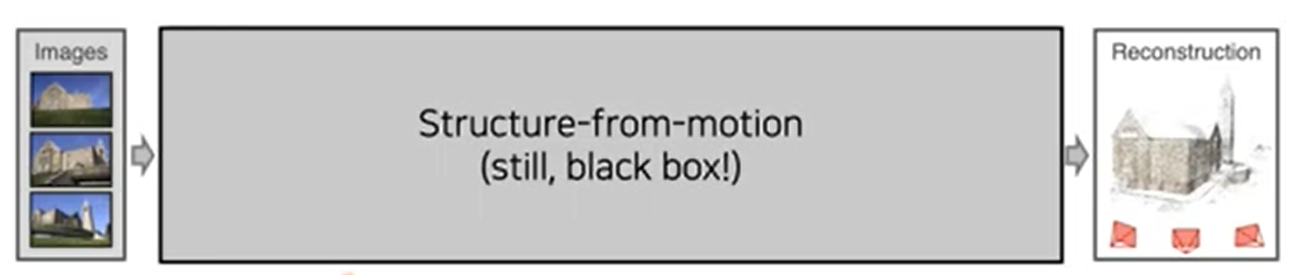
What is Structure from Motion?
Structure from Motion, or SfM, is a method within 3D reconstruction that estimates the three-dimensional structure of a scenes from a collection of two-dimensional (2D) images, such as photos taken from different angles.
Difference from Stereo: Uses multiple views, often from a single moving camera, rather than two fixed cameras.

Slide 45
SFM vs. Stero Vision
Feature | Stereo Vision | SfM
Camera Setup | Two fixed cameras | Single moving camera
Input | Pair of images | Sequence of images
Output | Depth map | 3D point cloud
Complexity | Moderate | High

Slide 46
How SFM Works ?
Feature Extraction:Identify distinct points (e.g., corners, edges) in each image.
Feature Matching: Find corresponding points across multiple images.
Camera Pose Estimation: Compute camera poses.
3D Reconstruction: Triangulate 3D points.
Bundle Adjustment: Optimize structure and poses.

Slide 47
Feature Extraction in SfM
Scale-Invariant Feature Transform (SIFT):
Detects keypoints invariant to scale and rotation.
Uses difference-of-Gaussians (DoG) pyramid.
Speeded-Up Robust Features (SURF):
Faster alternative using Hessian matrix-based blob detection.

Slide 48
Feature Matching
Find corresponding points in different images that represent the same location.
Use methods like nearest neighbor search and RANSAC to improve accuracy.
RANSAC (Random Sample Consensus) is an iterative algorithm used to estimate parameters of a mathematical model from a dataset that contains outliers (incorrect or noisy data points).

Slide 49
Steps of the RANSAC Algorithm:
Randomly select a small subset of the data points (just enough to estimate the model parameters).
Fit a model to this subset.
Count how many points (inliers) from the entire dataset fit this model well (within some tolerance).
Repeat steps 1–3 for a fixed number of iterations.
Select the model with the most inliers as the best estimate.

Slide 50
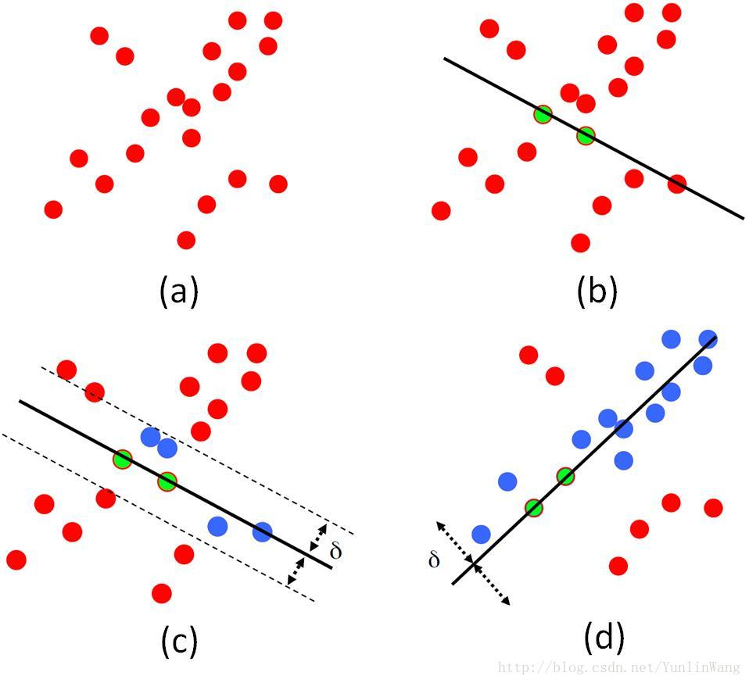

Slide 51
Camera Pose Estimation
Objective: Determine the camera’s position and orientation for each image.
Fundamental Matrix (F) → Relates corresponding points in two images.
Essential Matrix (E) → Extracts relative camera pose (R, t).
3D Reconstruction in SfM
Process of estimating 3D points by intersecting projection rays from two or more images.
Requires accurate camera poses and matched features.

Slide 52
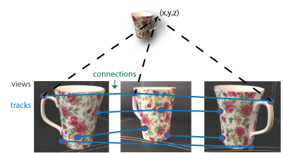
Bundle Adjustment
Objective: Optimize the entire reconstruction for accuracy.
Method: Minimize the reprojection error—the difference between observed 2D points and their projected positions—across all images and points, refining both camera parameters and 3D point locations. (nonlinear optimization).

Slide 53
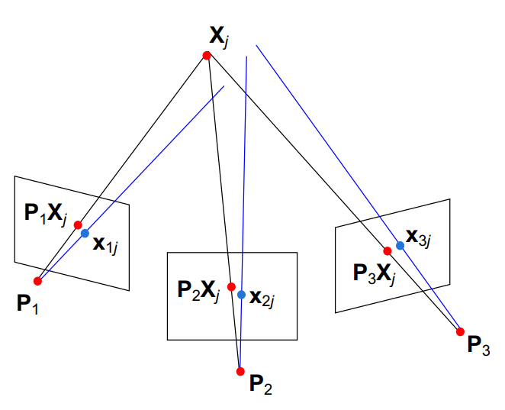
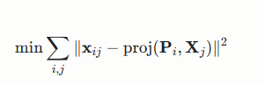
Bundle Adjustment
This nonlinear optimization minimizes the reprojection error, adjusting camera parameters Pi​ and 3D points Xj​ to best fit the observed 2D points xij​.

Slide 54
Structure from Motion, and SLAM
SfM is typically an offline process, handling unordered image sets for accurate reconstructions, while SLAM works in real-time with ordered data for navigation. Research suggests SfM emphasizes precision for static scenes, whereas SLAM balances speed and accuracy for dynamic environments, with some shared techniques like feature matching.

Slide 55
Simultaneous Localization and Mapping (SLAM)

Slide 56
SLAM
SLAM stands for Simultaneous Localization and Mapping, a foundational technology in robotics and artificial intelligence. It enables a robot or autonomous system to build a map of an unknown environment while simultaneously determining its own position within that map—without relying on external references like GPS.

Slide 57
Importance of SLAM
Enables Autonomy in Unknown Environments: SLAM allows robots, drones, and vehicles to explore, map, and navigate spaces where GPS or pre-existing maps are unavailable, making it vital for tasks like search and rescue, planetary exploration, and indoor navigation.
• Supports Reliable and Robust Navigation: By continuously updating both the map and the system’s position, SLAM provides more accurate and dependable localization than traditional methods, which is essential for safe and efficient autonomous operation.
• Facilitates Real-Time Decision Making: SLAM’s ability to process sensor data and update maps in real time enables robots and vehicles to adapt to dynamic and changing environments, improving their effectiveness and safety.

Slide 58
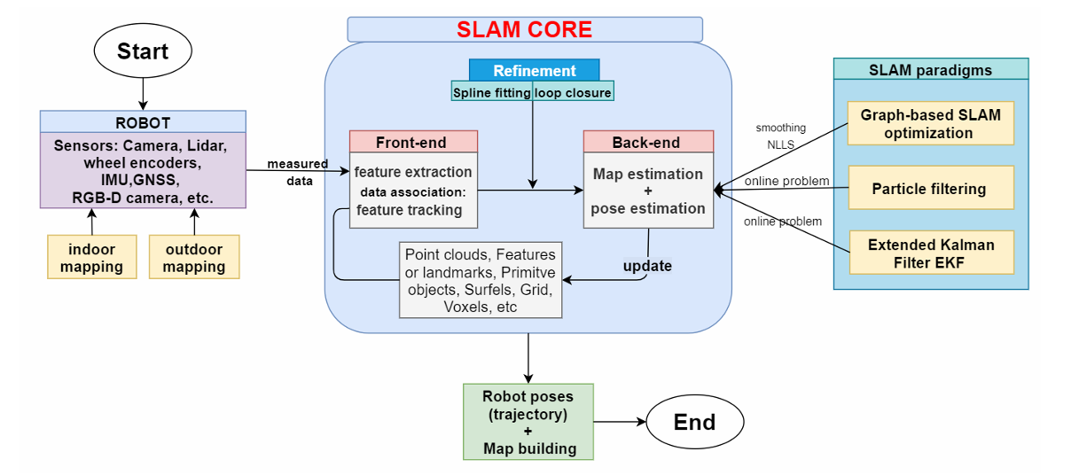
Structure of SLAM

Slide 59
SLAM Overview
Sensors: SLAM uses a variety of sensors (e.g. cameras – RGB or depth/RGB-D, LiDAR, IMU, wheel encoders, GNSS/GPS, etc.) to perceive the environment​.
Data Collection: These sensors collect data for both indoor and outdoor mapping (e.g. 2D LiDAR maps for indoor robots, 3D LiDAR/vision for drones and vehicles).
SLAM Core: The raw sensor data (images, scans, odometry, etc.) is fed into the SLAM core. The SLAM core processes this data to simultaneously estimate the robot’s pose (localization) and build a map of the environment.

Slide 60
SLAM Front-End Processing (Feature Extraction and Tracking)
Measured data from the robot’s sensors goes to the Front-end:
Feature extraction:
Detects important parts of the environment (points, edges, surfaces).
Examples: Corners of walls, distinctive textures.
Data association:
Matches features between different frames.
Tracks how features move as the robot moves (called feature tracking).
This creates point clouds or descriptions of the environment, which are sent for further processing.

Slide 61
3. Back-End Processing (Pose and Map Estimation)
The Back-end takes the tracked features and:
Map Estimation:
Builds a spatial representation (map) using observed features.
Pose Estimation:
Calculates the robot’s position and orientation in space over time.
As new measurements come, the back-end updates the map and pose.

Slide 62
Refinement: Spline Fitting and Loop Closure
Refinement makes SLAM more accurate:
Spline fitting: Smooths the estimated path of the robot.
Loop closure: Detects when the robot revisits a place and corrects accumulated drift in the map.
Without refinement, small errors over time could distort the entire map.

Slide 63
SLAM systems can use different methods to solve the localization + mapping problem:
Graph-Based SLAM:
Treats the robot’s poses and observed features as a graph.
Nodes = poses; Edges = relative measurements.
Solves using optimization (like Nonlinear Least Squares).
Particle Filtering:
Represents possible robot positions with a cloud of random samples ("particles").
Updates particles based on movement and sensor readings.
Extended Kalman Filter (EKF):
Predicts the robot’s next state based on its motion model.
Corrects the prediction using sensor measurements.
Best for small environments or when noise is low.

Slide 64
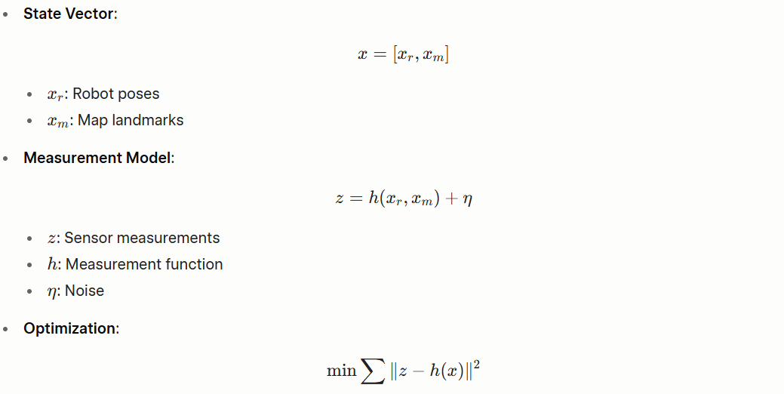
SLAM - Mathematical Framework

Slide 65
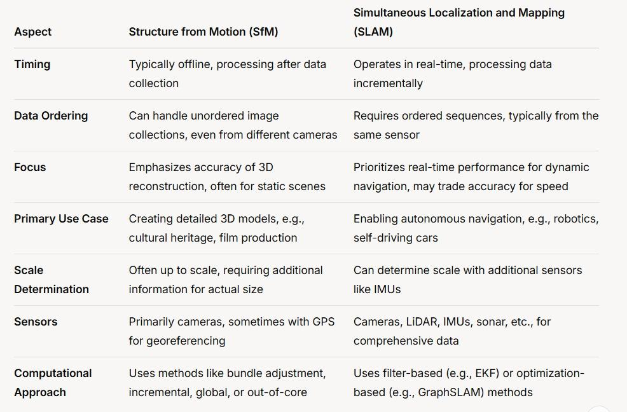

Slide 66
Applications in AR/VR and Robotics

Slide 67
Applications in AR/VR
Role: Enable devices to understand position and environment for immersive experiences.
Technologies Used:
SLAM
Stereo Vision
Depth Estimation

Slide 68
SLAM in AR
Function: Tracks device pose and maps environment to overlay virtual objects.
Examples:
ARKit: Apple’s AR platform using visual-inertial SLAM.
ARCore: Google’s AR platform for Android devices.
Process: Combines camera, accelerometer, and gyroscope data.

Slide 69
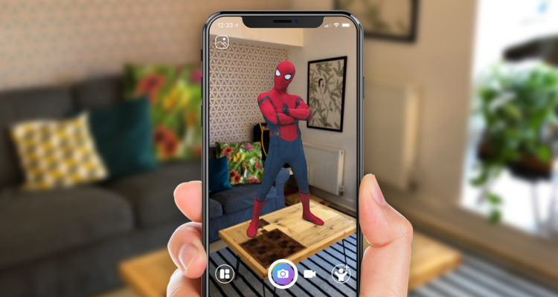

Slide 70
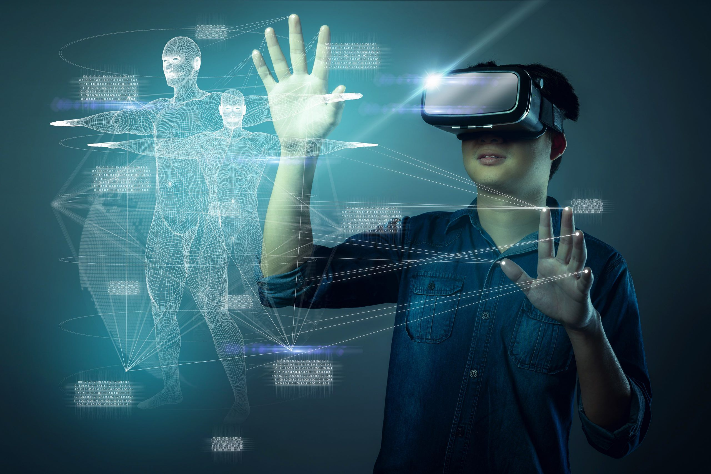
SLAM in VR
Inside-Out Tracking: Headsets track position using onboard cameras.
Benefits:
Eliminates external sensors.
Supports large-scale environments (up to 1,000 m²).
Example: Microsoft Mixed Reality headsets.

Slide 71
Applications in Robotics
Role: Enable autonomous navigation, mapping, and interaction.
Technologies Used:
SLAM
Stereo Vision
3D Reconstruction

Slide 72
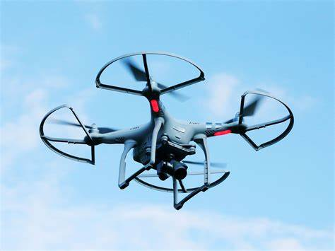
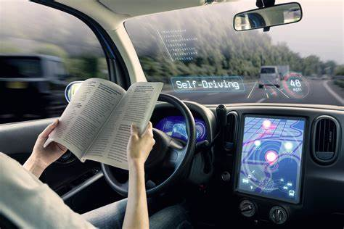
SLAM in Robotics
Function: Builds maps and localizes robots in unknown environments.
Applications:
Robot Vacuums: Efficient cleaning paths.
Drones: Autonomous flight and mapping.
Self-Driving Cars: Real-time navigation.

Slide 73
References
[1] L. Han, L. Fang, and Z. Liu, "Semantic-Aware 3D Reconstruction from Multi-View Images," IEEE Trans. Vis. Comput. Graphics, vol. 27, no. 5, pp. 2563–2572, May 2021, doi: 10.1109/TVCG.2021.3069442.
[2] Z. Wang, K. Ji, and Y. Wang, "Deep Learning-Based Monocular Depth Estimation: A Survey," IEEE Trans. Pattern Anal. Mach. Intell., vol. 43, no. 10, pp. 3607–3625, Oct. 2021, doi: 10.1109/TPAMI.2020.2988376.
[3] M. Buric, M. Dunnhofer, and C. Micheloni, "Graph-Based Visual SLAM with Dynamic Object Handling in Real-Time," in Proc. IEEE Int. Conf. Robot. Automat., 2022, pp. 5678–5684, doi: 10.1109/ICRA46639.2022.9811923.
[4] J. Zhang, M. Kaess, and F. Dellaert, "Photometric Visual-Inertial Odometry with Online Calibration of Attentional Biases," in Proc. IEEE Int. Conf. Robot. Automat., 2020, pp. 6721–6727, doi: 10.1109/ICRA40945.2020.9196895.

Slide 74
Thanks!

